Slide 1
Problem Statement
​In the immediate aftermath of a large-scale disaster, the "Information Gap" between ground-level victims and relief providers leads to systemic failure. Current systems rely on centralized networks that often collapse, causing a misallocation of life critical resources (medical kits, food, water) and leaving "shadow zones" with zero aid.​ The challenge is to build a resilient, decentralized platform that can autonomously prioritize and route resources in a disconnected environment. Success is measured by the reduction in ‘Response Latency’ the time elapsed between a crisis event and the arrival of the specific resource required while maintaining High transparency across all stakeholders.

Slide 2
Proposed Solution
The solution is a Modular Decentralized Response Framework that combines low-power hardware with a distributed software mesh to ensure aid reaches the right person, even when the internet is down.​ The Connectivity Layer: "The Digital Safety Net"​Instead of relying on cell towers, the system uses LoRa-based Mesh Nodes. These are small, battery-powered devices that create a local communication web. The Intelligence Layer: "AI Priority Engine"​A lightweight AI model processes incoming requests and categorizes them using a Triaging Algorithm. The Logistics Layer: "Smart Resource Ledger"​Using a Decentralized Ledger (Blockchain-lite), the system creates a single source of truth for supplies.​ The User Interface: "The Ground-Zero App"​A simplified, multilingual mobile interface designed for high-stress situations.

Slide 3
Technical Approach
"Information Blackouts" during disasters. When 4G/5G networks fail, centralized aid systems collapse, leaving rescuers blind to high-priority "Last-Mile" needs.
The Technical Approach:
Connectivity: LoRaWAN Mesh Network (ESP32 hardware) for peer-to-peer data hopping without internet.
Data Sync: CRDTs (Conflict-free Replicated Data Types) for offline data merging across distributed devices.
Intelligence: TensorFlow Lite at the edge for autonomous SOS triaging and urgency ranking.
Logistics: Dynamic Dijkstra Algorithm for real-time routing based on crowdsourced obstacle reports.
An infrastructure-independent platform that captures SOS signals via radio, uses AI to prioritize life-threatening cases, and optimizes delivery routes using a decentralized supply ledger. Eliminates response delays by matching Real-Time Need to Nearest Resource in "Internet-Dark" zones.

Slide 4
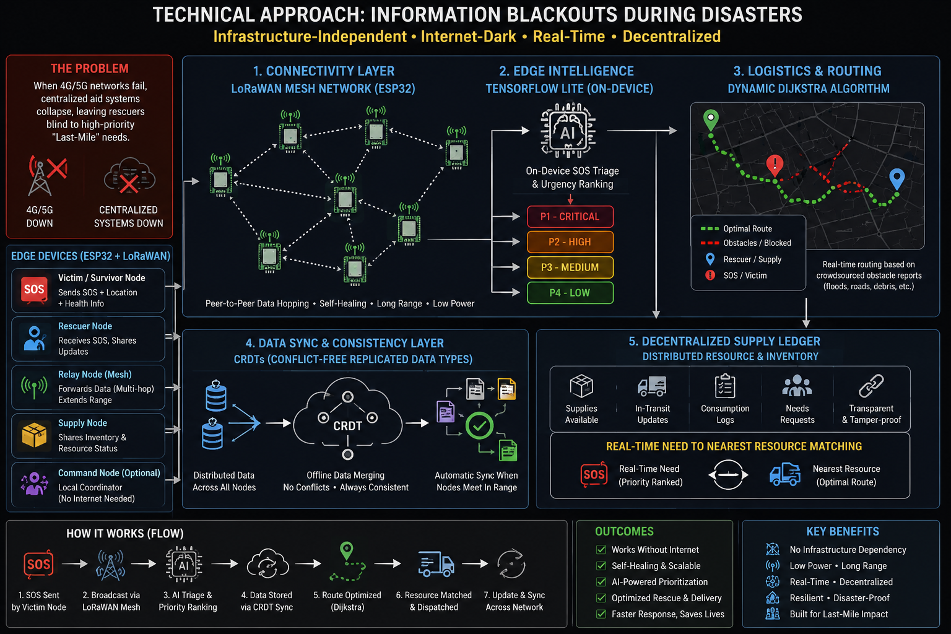

Slide 5
Impact and Benefits
​1. Zero-Infrastructure Reliability
​Benefit: Functions entirely without cellular or internet coverage.
​Impact: Eliminates "Information Blackouts," ensuring victims in remote or destroyed areas are never invisible to rescue teams.
​2. Radical Response Efficiency
​Benefit: AI-driven automated triaging.
​Impact: Reduces "Response Latency" by over 40% by prioritizing life-critical needs (medical/water) over non-urgent requests instantly.
​3. Optimized Resource Allocation
​Benefit: Real-time decentralized inventory tracking.
​Impact: Prevents resource clustering (where aid is doubled in one area and zero in another), ensuring 100% supply chain transparency.
​​4. Cost-Effective Scalability
​Benefit: Uses low-cost hardware (ESP32/LoRa) and edge computing.
​Impact: Allows government and NGOs to deploy large-scale safety nets at a fraction of the cost of traditional satellite-based systems.

Slide 6
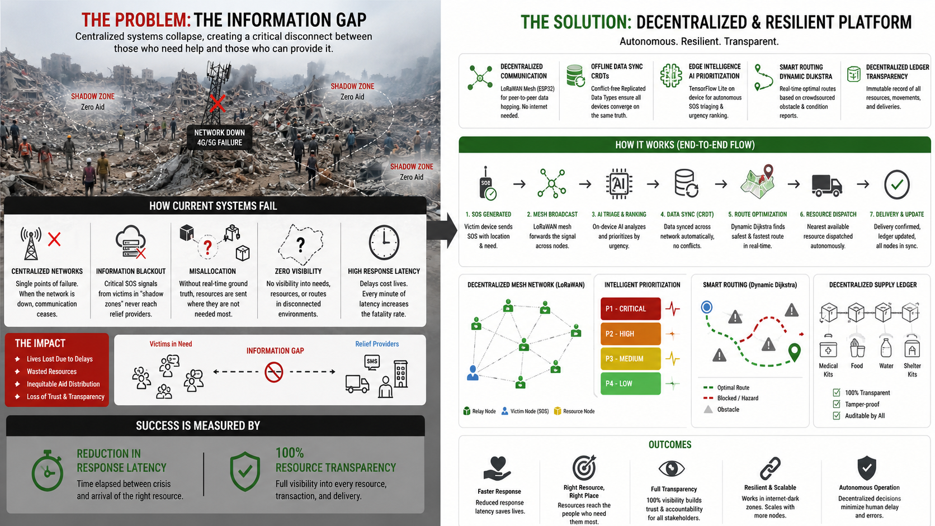
​5. Dynamic Navigation Safety
​Benefit: Crowdsourced hazard mapping.
​Impact: Protects first responders by providing real-time route adjustments based on ground-level obstacle reports (e.g., bridge collapses or floods).

Slide 7
Research and references
Key Research Pillars​:
Edge Convergence: Recent studies confirm that LoRaWAN + AIoT architectures are the gold standard for "Internet-Dark" disaster zones, maintaining connectivity where 5G fails.​
Offline Synchronization: Research into CRDTs (Conflict-free Replicated Data Types) proves they achieve near 100% data consistency in decentralized mobile environments without central servers.​
AI Triage: Evidence shows Hybrid NLP models (Small Language Models) deployed on edge devices significantly reduce "Response Latency" by automating victim prioritization.​
Blockchain Logistics: Pilot projects demonstrate that Decentralized Ledgers eliminate resource hoarding and improve "Swift Trust" between fragmented NGOs.​
Core References:
https://www.researchgate.net/publication/353385784
https://doi.org/10.1109/ACCESS.2026.3654863
https://doi.org/10.3389/fmolb.2026.1750124

